Slide 1

Leadership
May 2018
Jeff Fox and Shannon O’Connell
Notes:
Leadership Gallery—post leadership quotes and have them review and select one that comes closest to their vision of leadership.
Participant Introductions: name, city, CSO and what you would like to get out of this session? Post on flipchart.
Fox Introduction:
Canada\Liberia
Community\issue and political campaign experience
Love campaigns!
Beginning a journey today
Session Rules:
Phones on silent
One speaker
Get involved
Be on time
Ask questions
Have fun!

Slide 2

Session Agenda
What is Leadership?
Leadership vs Management
Leadership Styles
Leadership Tips and Tools
Crisis Management
Notes:
Brainstorm—what is your definition of leadership?

Slide 3

Some Say Leadership Is……
….. the process of social influence which maximizes the efforts of others. It is the ability to lead people towards the achievement of a goal through a clear vision.
Notes:
A leader is a person who influences a group of people towards a specific result.
Leadership is not dependent on title or formal authority
Exercise: Identify the 5 most important leadership traits. 5 minutes on flipchart. Examples--Influential, Trusted.

Slide 4
Typical Leadership Traits
Charismatic
Visionary
Persuasive
Inspires loyalty
Decisive
Intelligent
Independent
Good networker
Motivates others
Determined or Driven
Flexible or Adaptable
Good communicator
Trusted
Influential
Honest or Ethical
Strong
Likeable
Passionate
Purposeful or focused

Slide 5

Effective Leaders
Effective leaders are those who can clearly define goals that their teams or groups need to achieve, and actually reach or obtain those goals in a reasonable amount of time
Effective leadership is not quantitative, it is qualitative
Modern leadership is about outcomes: what happens as a result of your leadership?
Notes:
Have different participants read each statement as ask them what it means to them. Probe others.
In other words, how many people a leader influences or how much power he or she has is less significant than what she or he is able to achieve
Let’s talk now about the difference between being a leader vs a manager.

Slide 6
Leadership vs Management
The tasks of leading and of managing are distinct yet complementary; leaders must be capable of both
Leaders | Manager
Lead people | Manage tasks
Have followers or supporters | Have subordinates or team members
Some skills come naturally, some are learned | Skills are more likely to be learned

Slide 7
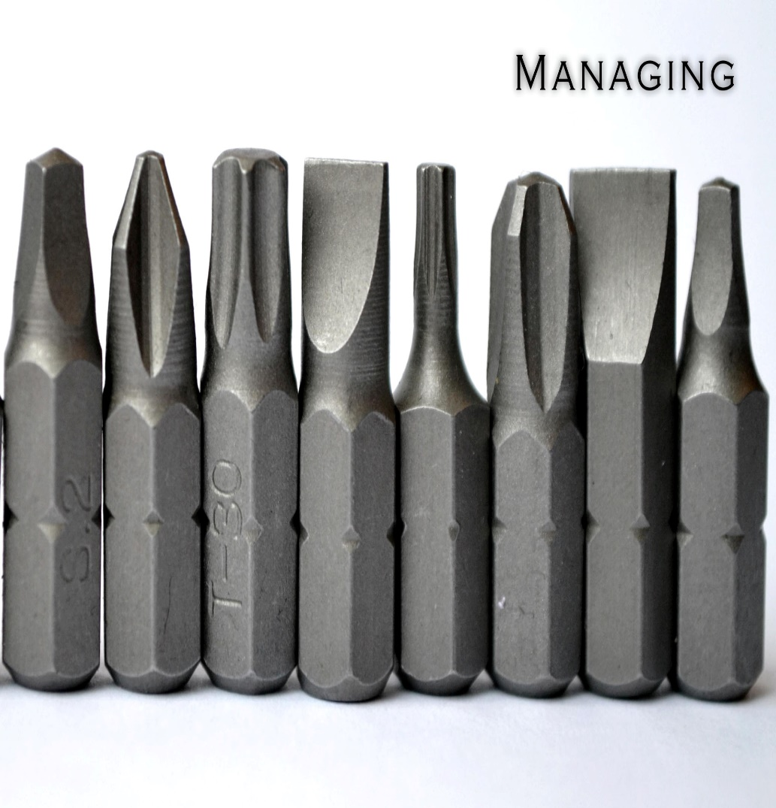
Management
Management is about coping with complexity or bringing order to a situation. It involves:
  Planning, budgeting, organizing, staffing, controlling processes and developments, creating systems for communication and solving problems
  Addressing ongoing day-to-day complexities in an organization
  Managers must create a positive, supportive climate which is conducive to creative and productive work

Slide 8

Leadership
Leadership is about setting direction, supporting people, coping with change and providing motivation. It involves:
  Motivating, coaching, empowering, building relationships, creating a shared vision and communicating that vision
  Leadership includes effectively orchestrating important change, as well as envisioning and creating a positive future
  Leaders must create motivation and loyalty among team members and a desire to achieve a shared vision.
Notes:
Team Exercise: Complete the management vs leadership questionnaire. 5 minutes.
Review Outcomes

Slide 9

Leadership Styles
Laissez-Faire Controlling
Situational
Transformational
Notes:
There are more than 250 definitions of leadership, based on decades of research
There are as many opinions about what makes a good leader as there are definitions
There is some common language to describe leadership characteristics, but it is not universal and can vary significantly
The questions remain:
What characteristics are part of leadership?
Are good leader born, are they shaped by their experiences, or both?
What makes an effective leader?
Discussion Point: Describe Laissez-Faire and Controlling.

Slide 10
Laissez-Faire vs Controlling
Controlling
Laissez-Faire
Laissez-Faire leaders avoid interfering in a group’s performance
Controlling leaders seek to be involved in all aspects of a group’s performance
Notes:
Controlling [Sisi\Trump\Duarte]
Little or no consultation with team members
Leader makes decisions
Orders issued, not discussed
Directive style
Laissez-Faire [Mahat Gandi\]
Leader actively avoids getting involved with a group’s work, including problems and decisions
Team members encouraged to “do their own thing” and “figure it out for themselves”
Lead by example
Discussion Point: Describe Situational Leadership

Slide 11
Situational Leadership
Supporting
Directing
Guiding
Delegating
Authoritative
Consulting
Notes:
Situational Leadership changes style based on the need.
Shifts between authoritative and consultative.

Slide 12
Situational Leadership
Consulting
Delegating
Supporting
Guiding or Coaching
Directing
Authoritative
Notes:
Examples of situational leadership?
Discussion Point: Describe transformational leadership.
Transformational leadership video

Slide 13

Transformational
Transformational leaders are those who work closely with those whom they lead to achieve a higher level of morale, motivation and performance. They:
  inspire team members to work for more than just self-gain
  encourage the use of innovation and initiative to challenge the status quo, achieve new types of success
  build consensus and support for the team’s goals and vision
Notes:
Transformational leadership starts with the leader being very closely involved in the work of his or her team.
Then gradually pulls away as systems start to work and team members become more autonomous and capable.

Slide 14
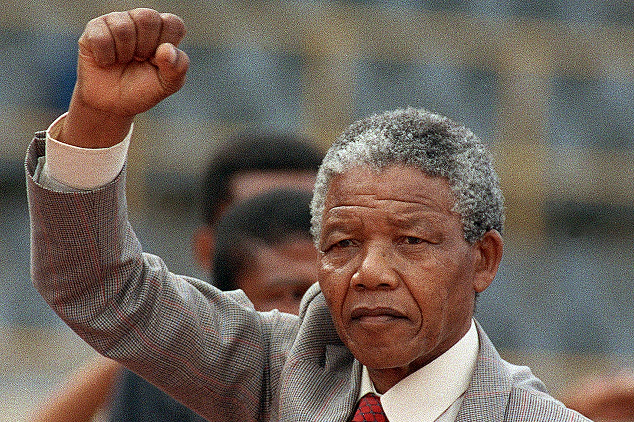
Notes:
Identify the leadership style, and tell us why, of each of the following international figures.
Transformational

Slide 15
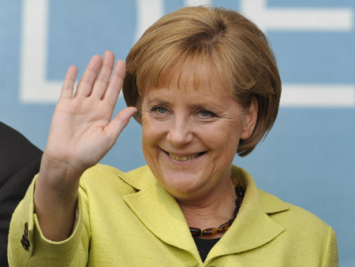
Notes:
Situational

Slide 16
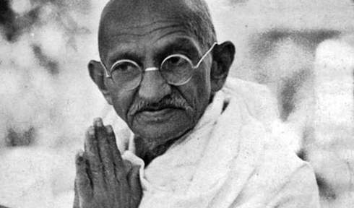
Notes:
Laissez-faire

Slide 17
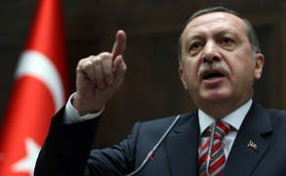
Notes:
Controlling
Exercise: distribute self-assessment questionnaire. Complete tonight and be ready to discuss tomorrow am.

Slide 18

Tips and Tools to be an Effective Leader
Notes:
Assigned each team one theme. They are to brainstorm and then present ideas on how to achieve the goal defined in their theme area.
Effective Communications
Building Your Team
The Art of Active Listening
Help Maintain Your Project Focus
Lead by Example
Getting to Know Your Team
10 minutes then present.

Slide 19

Effective Communications
set aside your authority--create atmosphere of partnership
focus on areas of agreement at the beginning
promote a culture of constructive dissent where you disagree
disagreements are simply a difference of opinion
thank people for their contributions and ideas

Slide 20

Building Your Team
be aware of expectations
ensure clear directions--responsibility, resources, timelines
integrity—group goals vs personal gain
provide on-going recognition
delegate responsibilities--share the work, share the pride
Notes:
friendliness--a simple thank you and smile goes a 1,000 miles
understanding--everyone makes mistakes
fairness--equal treatment, equal opportunity
be creative, avoid boredom

Slide 21

Help Maintain Your Project Focus
periodically remind everyone of your group’s purpose
provide encouragement and motivation
Maximize inclusion in discussions and decisions
Pro-actively resolve differences and disagreements
celebrate progress
Notes:
Is your plan practical and achievable?
Have adequate resources been provided?
Do you have clearly assigned responsibilities and timelines?

Slide 22
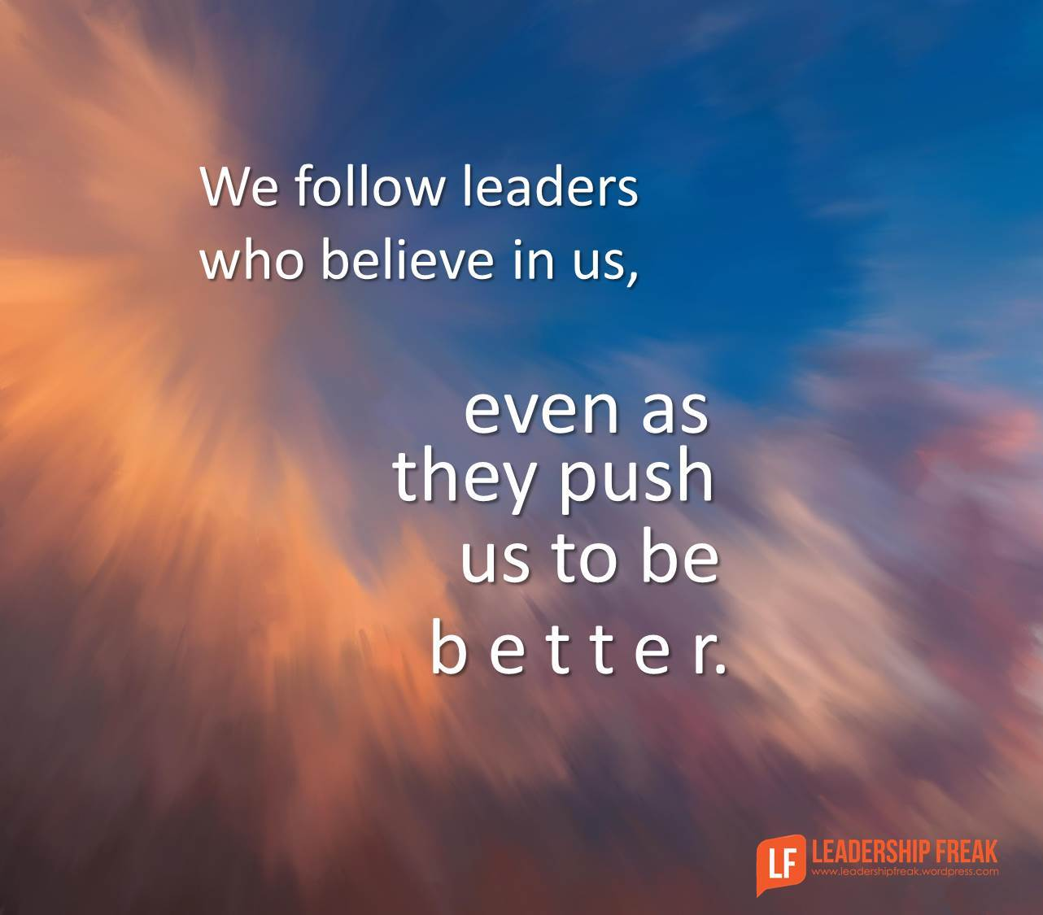
Lead By Example
take the initiative--set the example
offer help and information--mentor and support others
ask for advice if you need it--don’t be afraid to admit when you need help
be energetic, decisive and enthusiastic
know when and how to say no--understand your capacities and time limits

Slide 23

The Art of Active Listening
pay attention to what others are saying
show you are listening
ask questions
provide feedback
avoid judgement
respond respectfully and honestly
the respect you give is what you will receive!
Notes:
Tips:
focus on speaker, avoid distractions, avoid mentally preparing rebuttals
Body language critical. Posture, crossed arms, smile
summarize what you heard. Ask questions.
Allow them to finish! Avoid counterarguments.
Active Listening Exercise

Slide 24

Get To Know Your Team
everyone is different--abilities, wants, needs and purpose so get to know each person
spend as much time as possible with your team
over time become familiar with each member of your team
provide training support wherever needed
encourage and celebrate innovation and success
Notes:
be aware of expectations
be creative--avoid boredom
provide on-going recognition
delegate responsibilities--share the work, share the pride
ensure clear expectations--responsibility, resources, timelines
Discussion Point: what tools and tips would you use to resolve problems?
Video: show animation video.

Slide 25

A Guide to Resolving Problems
define problem simply and clearly
gather relevant information and resources
brainstorm ideas\solutions with others
evaluate options and choose the best one
design plan to implement solution
implement, monitor and evaluate

Slide 26

Crisis? What Crisis?
Notes:
Crisis Management Exercise—10 minutes then present.

Slide 27
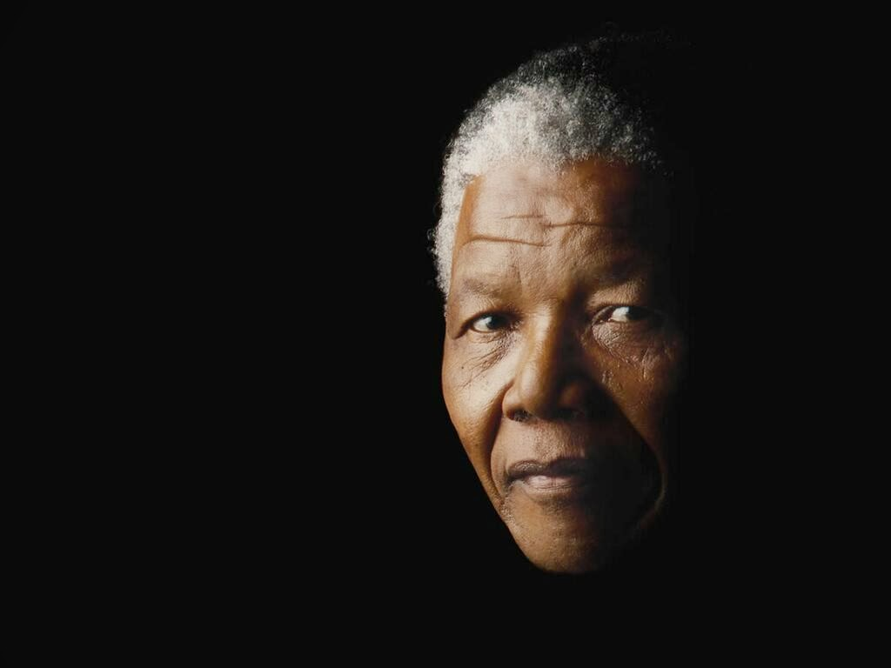
“It always seems impossible until it is done.”

