Slide 1
The Young Political Leadership School Africa Semester VI
TOPIC: ECOWAS VOLUNTEER PROGRAMME & OPPORTUNITIES FOR YOUNG PROFESSIONALS WITHIN THE ECOWAS REGION

Slide 2
INTRODUCTION
BRIEF HISTORY
The pilot phase (2010-2015) deployed volunteers mainly in post-conflict countries to Liberia, Sierra Leone and Guinea Bissau. The long-term phase, which began in January 2017, extends coverage to all ECOWAS member states. As a precondition, no international volunteer could serve in his country of origin.
The skills offered to host institutions are collected on a call / offer basis. Host countries and institutions indicate the type of skills they need in support of Peace and Development efforts and the Program responds to the demand for the identification, selection and recruitment of qualified volunteers in the region.

Slide 3
THE ROLE OF AN ECOWAS VOLUNTEER
Thus the role of the Volunteers consists among others:
Capacity building of local organizations to assist in the development and implementation of projects and programs in which volunteers participate;
Promoting the culture of peace;
Promotion of gender equality;
Establishing and supporting partnerships between communities
Networking and collaboration with other development partners;
Providing expertise and technical support to the host communities.
However, in the new sustainable phase, Volunteers can be recruited to serve in their home country

Slide 4
OBJECTIVE OF THE EVP
WHAT IS THE ECOWAS VOLUNTEER PROGRAM’S OBJECTIVE (EVP)?
The overall objective of the program is to develop a regional volunteering program in which ECOWAS youth (men and women) are united in their belief that peace and reconciliation can be used as development tools to consolidate peace in their country and in the sub-region.
The Program mobilizes volunteers in West Africa, and is committed to promoting the ideals and strategies of ECOWAS, including union, peace, democracy, sustainable development and regional integration.
EVP promotes the expertise and professional skills of citizens of the community for sustainable development and greater social impact under the themes: solidarity, union, hopes and dreams.

Slide 5
ECOWAS VOLUNTEER PROGRAM
SLOGAN:
PASSION - MOTIVATION - ACTION
OUR FIELD OF EXPERTISE:
HEALTH
EDUCATION
GENDER & WOMEN EMPOWERMENT
CIVIL SOCIETY
YOUTH & SPORT
MONITORING-EVALUATION
AGRICULTURE
COMMUNICATION

Slide 6
ECOWAS VOLUNTEER PROGRAM
STATISTICS:
174 - Volunteers deployed in three post-conflict countries;
13 - Nationalities;
14 - Areas of specialization in Health, Education, Youth & Sports, Agriculture, Gender/Women Empowerment among others.
EVP is well received by young people and beneficiary communities.
The program has demonstrated great social impact, and offers young people in the region the opportunity to make changes in their communities.

Slide 7
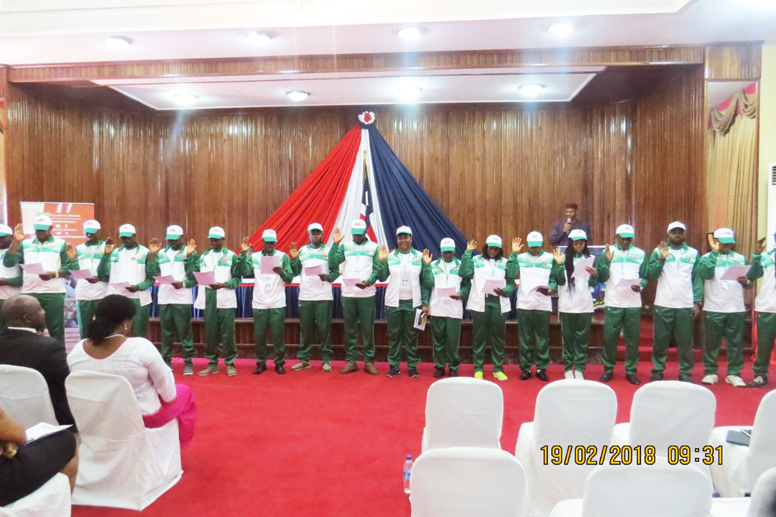
ACHIEVEMENTS

Slide 8
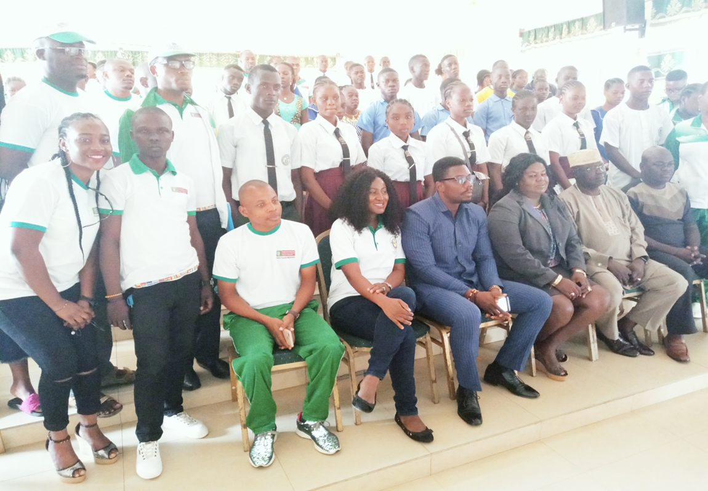

Slide 9
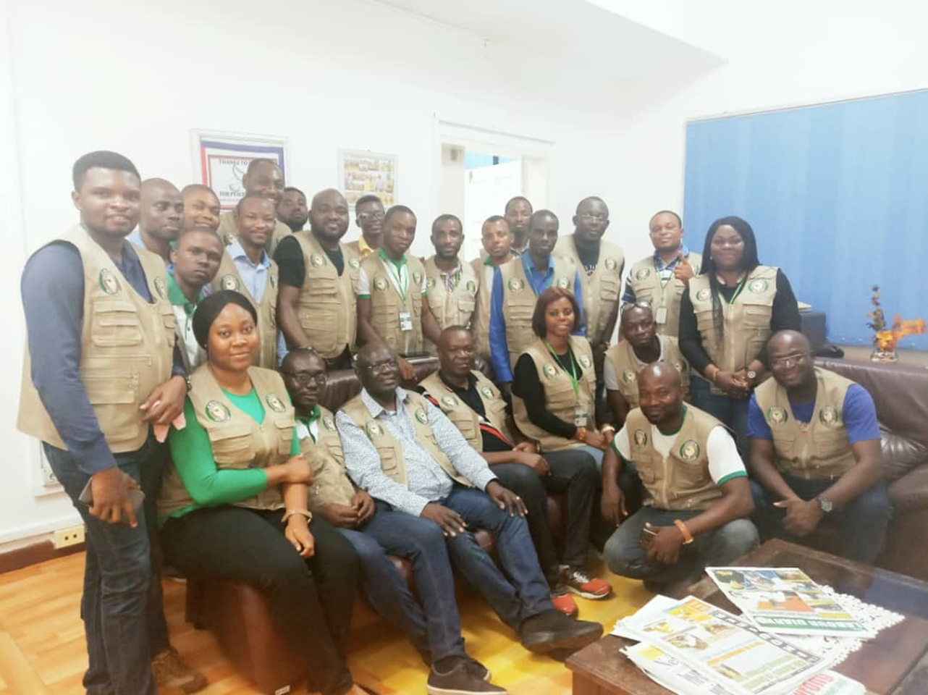
H.E Ambassador Babatunde Ajisomo, ECOWAS Military Team in Liberia & the ECOWAS volunteers

Slide 10
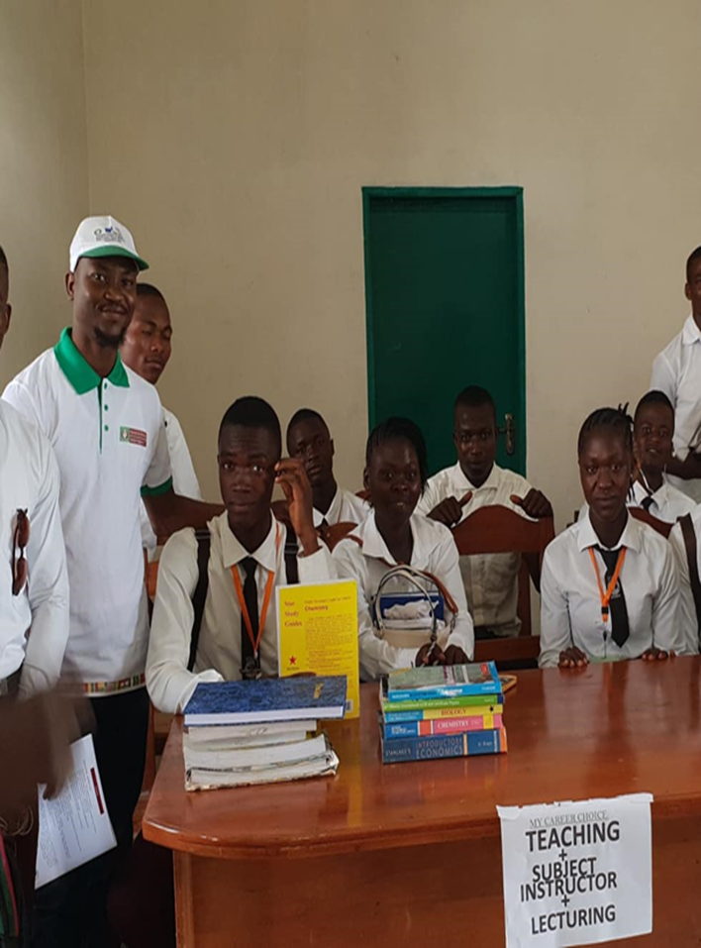
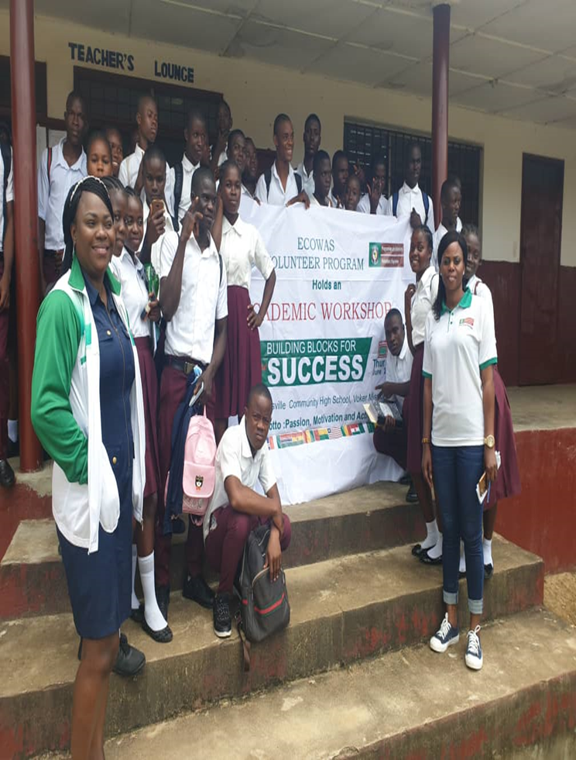

Slide 11
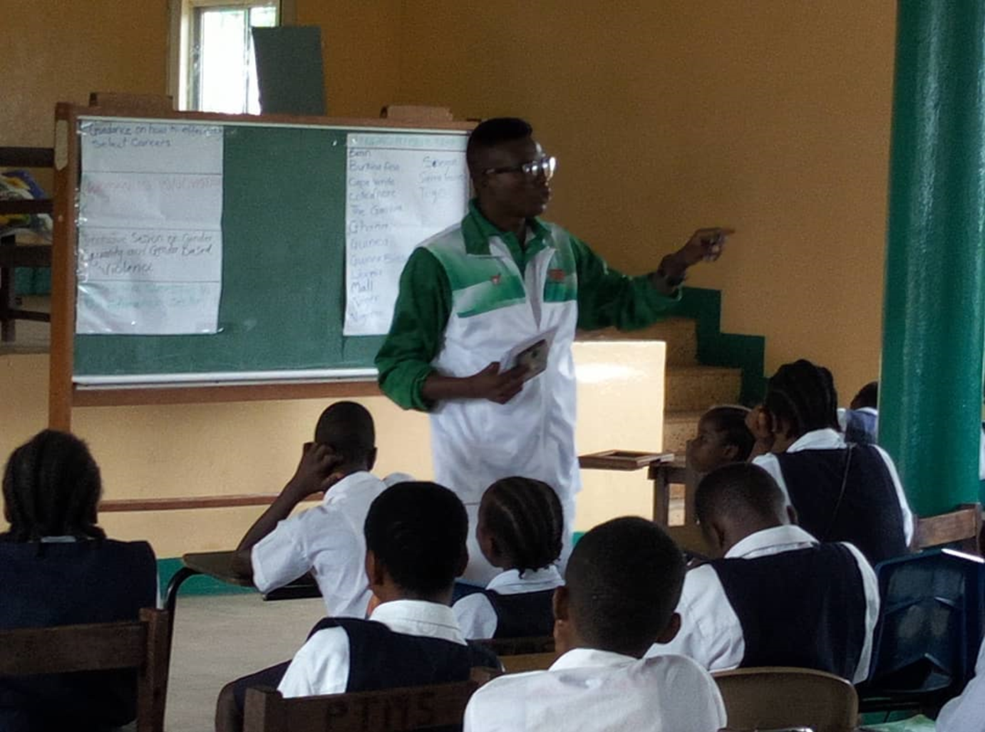
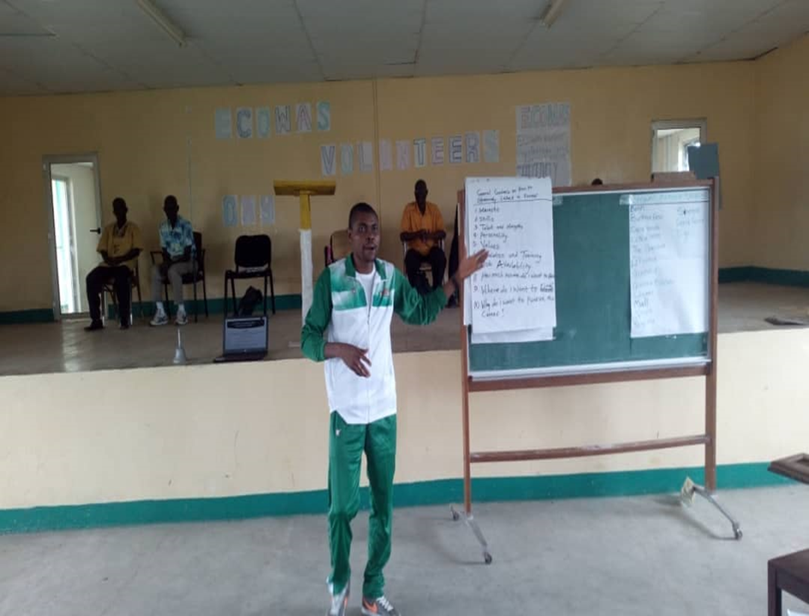

Slide 12
How to Become a Volunteer?
The selection criteria for the Volunteers are as follows:
Citizenship of ECOWAS countries;
Level of secondary education or proven skills in a given field;
Experience and / or demonstrated leadership ability;
Clean record ;
Voluntary experience (formal or informal);
A political (without commitment in any political activity);
Ability to adapt to different social, cultural and political conditions;
Commitment to serve as a volunteer
Living and working conditions

Slide 13
The conditions of service
Volunteers are deployed for a period of one year with a one-year renewal option;
Subsistence allowance is paid monthly to Volunteers in addition to life and health insurance coverage;
The volunteer is hosted by the host institution in a decent accommodation or receives housing benefits in lieu of accommodation by the host institution;
Each Volunteer receives an installation allowance at the beginning of their assignment and a relocation allowance is provided at the end of the assignment;
Return air transportation from the country of origin to the country of assignment is also provided.

Slide 14
OTHER OPPORTUNITIES FOR YOUNG PROFESSIONALS IN THE ECOWAS REGION
ECOWAS Youth and Sport Development Centre
DEVELOPMENT OF ASSOCIATIVE LIFE AND YOUTH ORGANISATIONS
ECOWAS youth forum
YOUTH SOCIO-ECONOMIC INTEGRATION
Youth Employment
Elaboration of a databank on jobs and vocational training opportunities
SOLIDARITY AMONG YOUNG PEOPLE
Involving young girls In peace building
Organisation of young entrepreneurs show
The ECOWAS volunteers programme
ECOWAS BANK FOR INVESTMENT AND DEVELOPMENT
The Young Professional Recruitment Programme - The programme is designed for high calibre young professionals who will not be more than thirty (30) years at the time of recruitment. The selected candidates will be appointed as Young Trainee Professional Staff in the Bank under a two (2)-year fixed term contract. The candidates will observe a probationary period of six (6) months during which each party may terminate the relationship without prior notice.
ECOWAS Commission Court of Justice
Internship Training Program at the ECOWAS Commission Court of Justice - the programme is aimed at fostering youth employment and providing a practical learning framework in their areas of university training

Slide 15
Lawyers/International Relations
ECOWAS Commission
Human Resources Department– Human resource personnel, Administration Management
Languages – Interpreters and Translators
Industrial Development
Finance/Accounting / Economists / Development studies (Masters Degree)
Infrastructural Regional Projects
Civil Engineers/ Mechanical Engineers/ Marine Engineers/ Marine Brokers
ICT / ECOLINK
CCC – Communication Centre
Political Affairs Peace and Security
Peace and Security
Democracy and Good Governance
Elections & Monitoring
Mediation and facilitation
Department of Regional Peace and Security
ECOWAS Civilian Database roster
N/B: We are surrounded by Franco-phone countries, we see no reason why we as youths cannot influence the government to take us to these countries to learn these languages.

Slide 16
Department of Agriculture, Water resources and Environmental
Animal Husbandry, Environmental Specialist, Water engineers
ERERA/WAP(Department of Energy)
Engineers in power sector/ Renewable Energy, Solar and wind energy engineers
WAHO
Health Specialist, Traditional medicine, community and public health, Pharmacy
GIABA (Intergovernmental action against money laundering and Terrorism Financing)
Forensics (They provide a lot of training)
ECOWAS Radio
Mass communicators, Producers, Journalists

Slide 17
REFERENCES:
www.ecowas.int
http://www.eysdc.ecowas.int/
www.ecowasvolunteer.com
http://www.bidc-ebid.org/english/young-professionals-programme/

