Slide 1
Practical Steps for Networking and Advocacy for Policy Reform
S. Aaron Weah-Weah, III

Slide 2
Objectives:
Definition:
Networking
Advocacy
Policy and Public Policy
Understanding Policy Development
Context for Policy Development
Stages for Policy Development
Conducting Advocacy for Policy Reforms

Slide 3
What is Networking?
The action or process of interacting with others to exchange information and develop professional or social contacts.

Slide 4
What is Advocacy?
Public support for or recommendation of a particular cause or policy.

Slide 5
What is Policy?
Policy guides our actions and tells us:
What is to be done
Who is to do it
How it is to be done
To whom does the policy apply

Slide 6
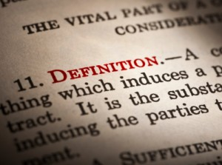
Definition of Policy
A set of ideas or a plan of what to do in particular situations that have been agreed to officially by a group of people, a business, a government or a political party.

Slide 7
Definition of Public Policy
…a system of "courses of action, regulatory measures, laws, and funding priorities concerning a given topic adopted by a governmental entity or its representatives."

Slide 8
NETWORKING + ADVOCACY = POLICY REFORM

Slide 9
Contexts for Policy Development
Elections:
present ideas to voters
contrast with the opponents
Issue Management:
Responding to needs or demands from citizens, business, the courts, ministries, etc.
Governing parties:
Clear legislative and policy agenda for the country
Opposition parties:
Challenge the ideas of the government
Monitor their results

Slide 10
Policy is about the Problem-Solution Relationship
Problem
Solution

Slide 11
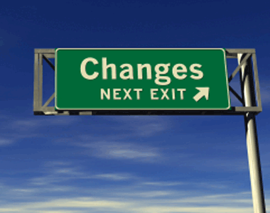
What Do You Want to Achieve?
What change would you like to see happen as a result of your issue campaign?
Notes:
Team Exercise: clearly identify what you want to see happen as a result of your issue campaign being successful.
Simple, clear statement. What is your end goal?

Slide 12
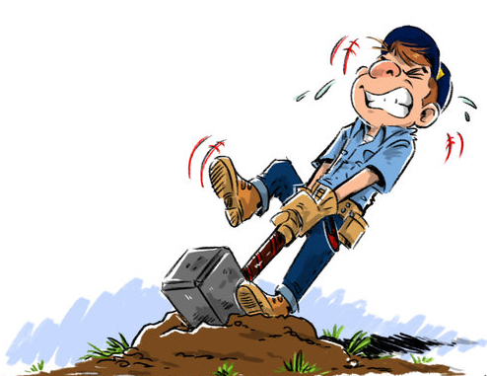
How Can You Achieve Change?
How can you fix it?
What is the solution?
Notes:
Choose two issues – divide to groups of five –
It is highly likely that the different groups working on the same issue will come up with completely or slightly different solutions. If this is the case, ask the participants what they think of this. Guide the conversation to the learning point that each problem can be addressed in many different ways and that there is always more than a single solution.

Slide 13
Stages of Policy Development
Issue Identification
Development of Policy Options
Selection of Policy
Message Development and Delivery
Implementation and Tracking
Research
Notes:
Issue Identification—what to you want to change?
Research—what research to you need to create the evidence for change
Development of Policy Options—identify different actions which could be adopted to affect positive change
Selection of Policy—which is your preferred policy change?
Message Development and Delivery—what is your message to support the need\benefits for change
Implemantation and Tracking—monitoring and track the change implementation and its impacts

Slide 14
Conducting Advocacy for Policy Reforms
Clear Objective
Defined Targets
Primary Audiences
Primary audiences are individuals, institutions, commissions, committees and stakeholders that have the leverage/power to make the necessary changes. Eg. Lawmakers, Ministers, House Standing Committees etc.
b. Secondary Audiences
Secondary audiences are those who can influence individuals, institutions, commissions, committees and stakeholders with the leverage/power to make necessary change. Eg. Citizens, Media Institutions etc.

Slide 15
Conducting Advocacy for Policy Reforms
Allies/Partners:
Individuals, institutions that are willing and/or advocating for similar policy reforms.
Development of Messages:
Key messages that are SMART and resonate with the targeted audiences.
Development Activities and Outputs:
Activity | Outputs | Responsible Party | Timeframe

Slide 16
Issue Identification
Identify issues that require a policy response through:
Research
Feedback from citizens, constituents and voters
Emerging challenges, problems and opportunities
Crisis
Consistent (and persistent) obstacles to growth, development and stability
Core values, vision and electoral commitments

Slide 17
S
Specific: Target
M
Measurable: Quantify
A
Assignable: Specify who
T
R
Realistic: What results
Time Bound: Specify when
Notes:
When setting your goals you have to make a distinction between end-goals and performance goals.
An end-goal is a wish, a performance-goal is the road that leads to that goal
When your goal is not attainable, there is no hope. When your goal is not challenging, it will not motivate you.
Team Exercise: Develop 3 policy actions that could be adopted to provide positive change for your campaign issue—short-term, mid-term and long term.

Slide 18
Solution Costing
Everything costs something
Need to identify the costs of your recommended actions
Look for alternative or new funding options.
Notes:
Action costing and ideas for funding will be critical credibility tools for elected offcials.

Slide 19
WHO WILL CRY FOR YOU WHEN DIE?
THANK YOU

