Slide 1
A Facilitator’s guide to participatory decision-making
BY: S. Aaron Weah-Weah, III
Program Director
NAYMOTE

Slide 2
Learning Objectives:
Have a better sense of the various roles and settings in which facilitators operate;
Assess and distinguish between skills for negotiation, mediation, and facilitation;
Learn effective tools and strategies for facilitating;
Practice these tools and strategies in a collaborative learning environment
Develop additional capacity around receiving and giving feedback;
Learn new frameworks for understanding and managing group dynamics for better outcome;

Slide 3
A Partial History of Facilitation
The process of facilitation and facilitator is over 3,000 years old. The concept evolved from facilitative learning to the concept of group facilitation. The philosophy, mind-set and concept of facilitation have a lot in common with approaches used by Gandhi, Martin Luther King Jr. and many non-violence movement over centuries.
More recently these include the civil rights movement, women’s consciousness-raising groups, some parts of the environmental movement, and citizen involvement groups that started in the 1960s and 1970s.
Meeting facilitation started to appear as a formal process in the late 1960s and early 1970s and had become widespread by the late 1980s.

Slide 4
What is Facilitation?
The Latin root of facilitate means “to enable, to make easy.” Facilitation has evolved to have a number of meanings today.
Facilitation (or group facilitation) is generally considered to be a process in which a neutral person helps a group work together more effectively. Facilitators may work with small groups within an organization, or with representatives of different organizations who are working together in a collaborative or consensus-building process.
Notes:
Facilitation" is a term that means different things to different people. In the context of U.S. alternative dispute resolution (ADR),

Slide 5
Terms to Knows
A facilitator is an individual who enables groups and organizations to work more effectively; to collaborate and achieve synergy. She or he is a “content-neutral” party who by not taking sides or expressing or advocating a point of view during the meeting, can advocate for fair, open, and inclusive procedures to accomplish the group’s work. A facilitator can also be a learning or a dialogue guide to assist a group in thinking deeply about its assumptions, beliefs, and values and about its systemic processes and context.

Slide 6
Terms to Know Cont’d
A facilitative leader is a leader who is aware of group and organizational dynamics; a leader who creates organization-wide involvement processes that enable members of the organization to more fully utilize their potential and gifts in order to help the organization articulate and achieve its vision and goals, while at the same time actualizing its spoken values. Facilitative leaders often understand the inherent dynamics between facilitating and leading and frequently utilize facilitators in their organizations.

Slide 7
Terms to Know Cont’d
A facilitative group (team, task force, committee, or board) is one in which facilitative mind-sets and behaviors are widely distributed among the members; a group that is minimally dysfunctional and works very well together; a group that is easy to join and works well with other groups and individuals.

Slide 8
GROUPS DYNAMICS
PARTICIPATORY GROUPS
CONVENTIONAL GROUPS
Everyone participates, not just the vocal few.
The fastest thinkers and most articulate speakers get more airtime.
People give each other room to think and get their thoughts all the way out.
People interrupt each other on a regular basis.
Opposing viewpoints are allowed to co-exist in the room.
Differences of opinion are treated as conflict that must either be stifled or “solved.”
People draw each other out with supportive questions. “Is this what you mean?”
Questions are often perceived as challenges, as if the person being questioned has done something wrong.
Each member makes the effort to pay attention to the person speaking.
Unless the speaker captivates their attention, people space out, doodle or check the clock.

Slide 9
THE DYNAMICS OF GROUP DECISION-MAKING
➧ Misunderstandings About the
Process of Group Decision-Making
➧ The Struggle to Integrate Diverse
Perspectives
➧ The Diamond of Participatory
Decision-Making

Slide 10
Selective Attention
https://youtu.be/vJG698U2Mvo
https://youtu.be/IGQmdoK_ZfY

Slide 12
Misunderstandings About the Process of Group Decision-Making
Decision Point
THE DYNAMICS OF GROUP DECISION-MAKING
NEW
TOPIC
✔

Slide 13
THE DYNAMICS OF GROUP DECISION-MAKING
This picture portrays a hypothetical problem-solving discussion.
Each circle – – represents one idea. Each line of circles-and-arrows represents one person’s line of thought as it develops during the discussion.
As diagrammed, everyone appears to be tracking each other’s ideas, everyone goes at the same pace, and everyone stays on board every step of the way.
A depressingly large percentage of people who work in groups believe this stuff. They think this picture realistically portrays a healthy, flowing decision-making process. And when their actual experience doesn’t match up with this model, they think it’s because their own group is defective.
If people actually behaved as the diagram suggests, group decision-making
would be much less frustrating. Unfortunately, real-life groups don’t operate this way.

Slide 14
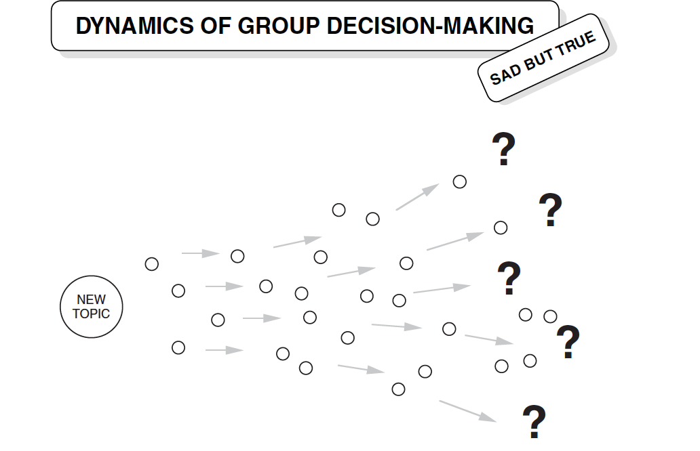
The Struggle to Integrate Diverse Perspectives

Slide 15
The Struggle to Integrate Diverse Perspectives
Group members are humans. We do go on tangents. We do lose track of the central themes of a discussion. We do get attached to our ideas. Even when we’re all making our best effort to “keep focused” and “stay on track,” we can’t change the fact that we are individuals with diverging points of view.
When a discussion loses focus or becomes confusing, it can appear to many people that the process is heading out of control. Yet this is not necessarily what’s really going on. Sometimes what appears to be chaos is actually a prelude to creativity.
But how can we tell which is which? How do we recognize the difference between a degenerative, spinning-our-wheels version of group confusion and the dynamic, diversity-stretches-our-imagination version of group confusion?

Slide 16
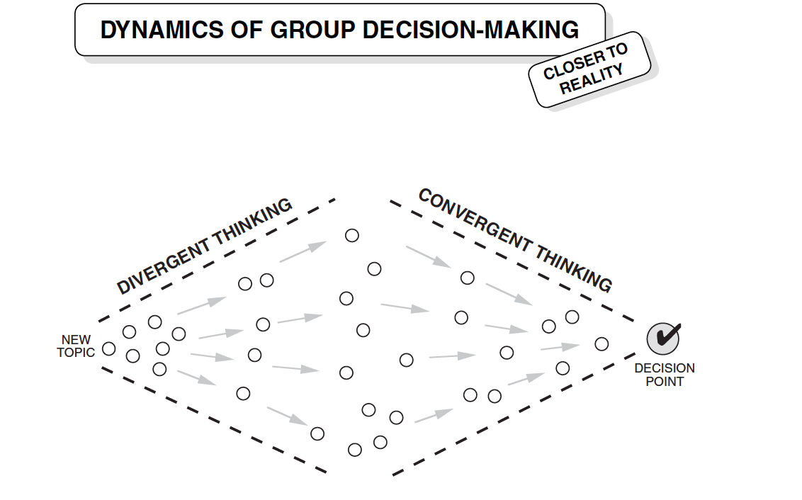
The Diamond of Participatory Decision-Making

Slide 17
The Diamond of Participatory Decision-Making
At times the individual members of a group need to express their own points of view. At other times, the same people want to narrow their differences and aim the discussion toward closure. These two types of “thinking processes” are referred to as divergent thinking and convergent thinking.
Here are four examples:
DIVERGENT THINKING CONVERGENT THINKING
Generating alternatives VS Evaluating alternatives
Free-flowing open discussion VS Summarizing Key Points
Gathering diverse points of view VS Sorting Ideas into Categories
Suspending judgment VS Exercising Judgment this way

Slide 18
Tools for Participatory Decision-making
A facilitator needs to ensure the group is firstly demonstrating the four (4) main core values of a group participatory decision-making.
The core value include:
• Full participation
• Mutual understanding
• Inclusive solutions
• Shared responsibility

Slide 19
Tools for Participatory Decision-making
To do that the facilitator works continuously to achieve three ongoing objectives:
Build and sustain a respectful, supportive atmosphere
Stay out of the content and manage the process
Teach the group new thinking skills as the process unfolds, in order to build their capacity for collaboration.

Slide 20
Tools for Participatory Decision-making
There are several tools that facilitators use to reach group outcome during the three stages of participatory decision-making. Some of these tools include:
Paraphrasing 3. Suspended Judgment
4. Drawing people out 5. Brainstorming
6. Active listening 7. Acknowledging feelings
8. Mirroring 9. Legitimizing differences
10. Non-verbal language 11. Chartwriting techniques
12. Scanning 13. Sticky Notes
14. Caucusing 15. Listening to common ground
16. Feedback 17. Intentional silence

Slide 21
Things you will need to facilitate a group meeting
Pre assessment meeting with group
2. Develop an Agenda
Flip Chart stand and pad
Markers of different colors
A suitable and accessible venue
Sitting Arrangement
A co-facilitator if necessary

Slide 22
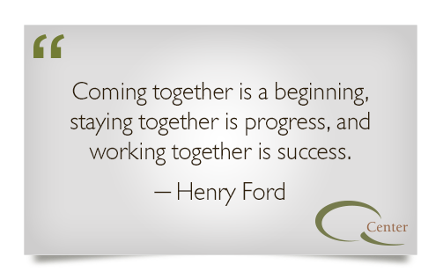
THANK YOU

